Slide 1
JANUARY–JUNE PERFORMANCE REVIEW
Bright Coffee Shop
Sales Analysis
Key insights and action plan
Notes:
This review covers January through June performance, the patterns visible in the dashboard, and the operating actions those patterns support.

Slide 2
Bright Coffee Shop Sales Analysis
EXECUTIVE READOUT
Strong half-year momentum, with clear operating opportunities
The business has scale, a balanced store base, and a clear set of demand patterns to act on.
$698,812
214,470
149,116
80
Transactions
Unique products
Revenue · January–June
Units sold
June is the strongest visible month. Coffee and tea lead category revenue, while the broad product range creates room to grow basket size.
02
Notes:
The headline is strong half-year momentum. The opportunity is operational: use the demand patterns to improve basket size, staffing, replenishment, and cross-store learning.

Slide 3
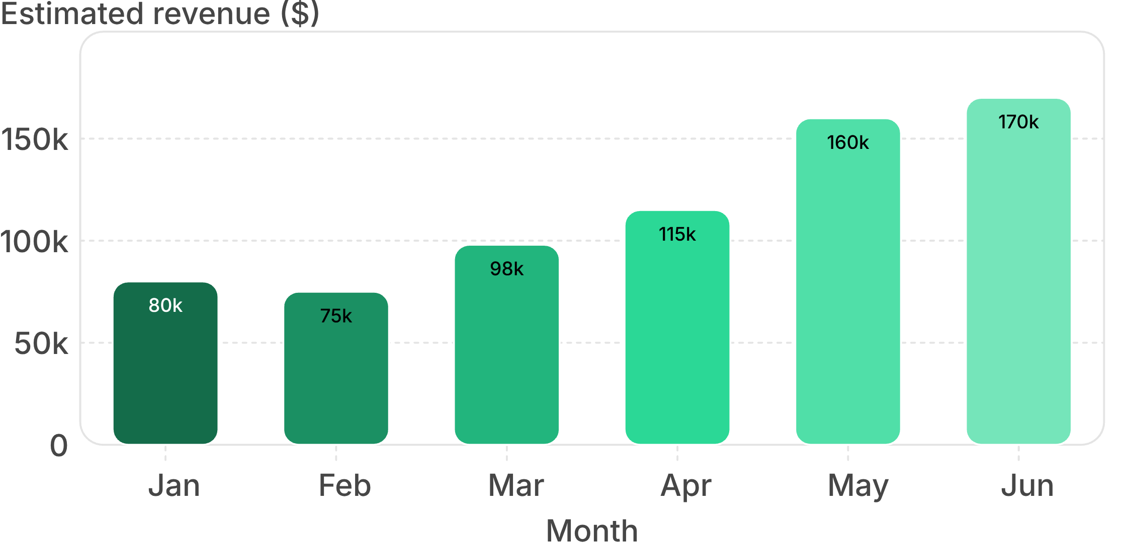
Bright Coffee Shop Sales Analysis
MONTHLY REVENUE · ESTIMATED DASHBOARD VALUES
Revenue rises steadily from February through June
June is the visible high point
February is the low point at approximately $75k. Revenue then climbs through June, reaching approximately $170k.
✓ Momentum strengthens after February
Approximate values from the dashboard; chart labels are estimates.
03
Notes:
The chart shows a small February dip followed by a steady rise, with the largest step-up arriving in May and June. The dashboard shows what changed, not why it changed.

Slide 4
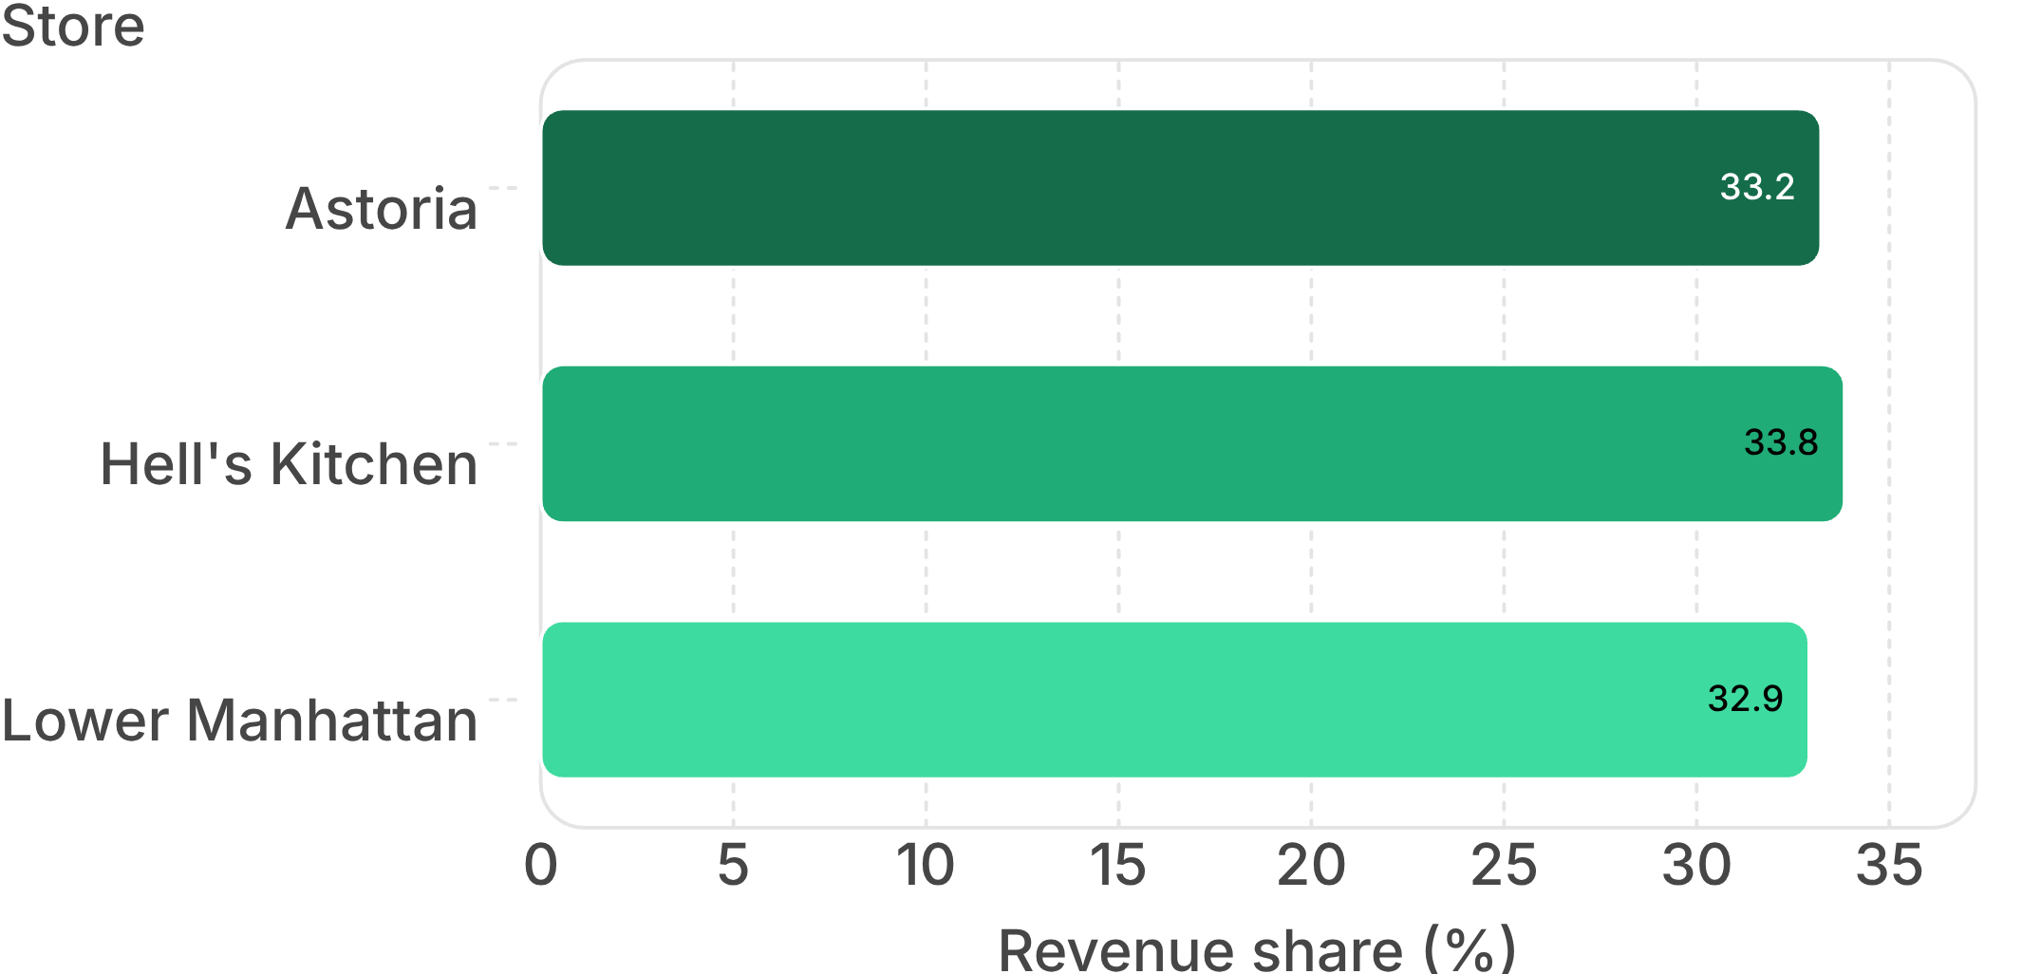
Bright Coffee Shop Sales Analysis
STORE CONTRIBUTION · ESTIMATED SHARE
All three stores contribute almost equally
Balance is the insight
Hell's Kitchen leads at 33.84%, followed by Astoria at 33.23% and Lower Manhattan at 32.92%.
✓ Share best practices across stores
Approximate shares from the dashboard; the gap is less than one percentage point.
04
Notes:
No store is materially ahead. The operating implication is to share what works across all three locations rather than over-focus on one store.

Slide 5
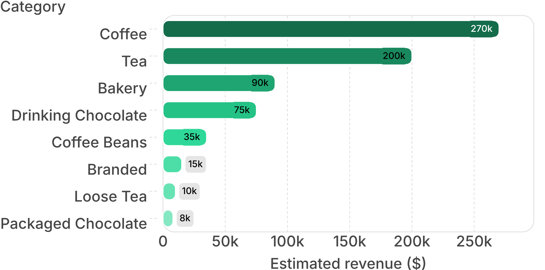
Bright Coffee Shop Sales Analysis
CATEGORY MIX · ESTIMATED REVENUE
Coffee and tea drive the category mix
Lead with the beverage
Coffee and tea are the strongest revenue engines. Bundles and add-on prompts can connect them to bakery, beans, and branded products.
Approximate category values from the dashboard.
05
Notes:
Coffee contributes approximately $270k and tea approximately $200k. Smaller categories are the attach-rate opportunity, not the primary revenue engine.

Slide 6
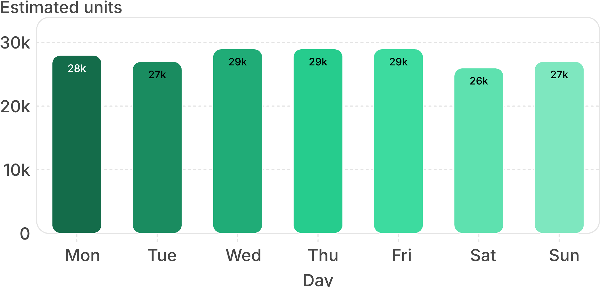
Bright Coffee Shop Sales Analysis
WEEKLY DEMAND · ESTIMATED UNITS
Weekday demand is stable, with a narrow peak
Protect the baseline
Core demand is consistent. Saturday is lowest at approximately 26k, so test targeted weekend offers instead of broad discounting.
✓ Focus the test on Saturday
Approximate units from the dashboard; Wednesday through Friday form the narrow peak.
06
Notes:
Wednesday, Thursday, and Friday are each around 29k units. The range is narrow enough to keep core staffing consistent while testing a focused response to the weekend gap.

Slide 7
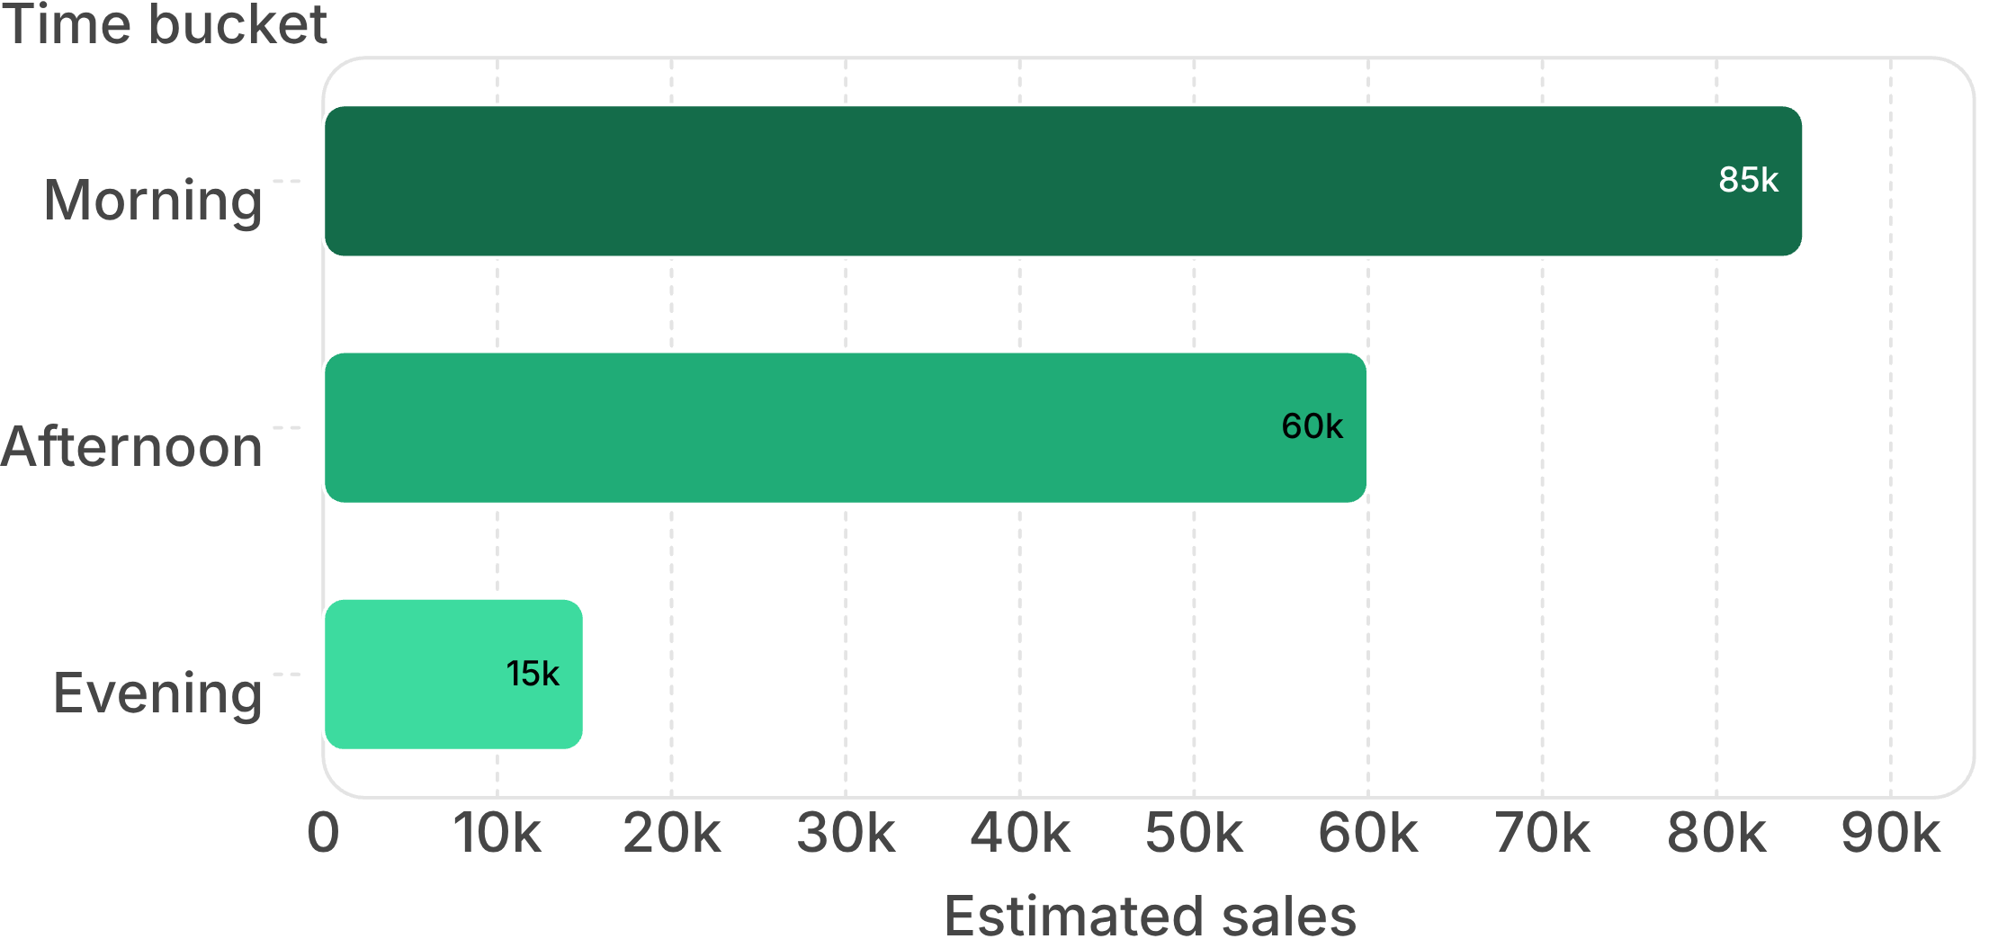
Bright Coffee Shop Sales Analysis
TIME OF DAY · ESTIMATED SALES
Morning is the busiest service window
Win the opening hours
Morning demand is more than five times the visible evening volume. Prioritize readiness, fast-moving inventory, and peak-period staffing.
✓ Staff and replenish for morning
Approximate sales values from the dashboard.
07
Notes:
Morning sales are approximately 85k, versus 60k in the afternoon and 15k in the evening. The first operating priority is peak execution, not additional evening capacity.

Slide 8
Bright Coffee Shop Sales Analysis
PERIOD CLOSE · DISCIPLINED INTERPRETATION
June closes the period at the visible peak
36k
$170k
Approximate June monthly sales
Approximate June revenue
January begins near 18k, with only a small February dip.
February revenue is approximately $75k.
Momentum strengthens materially in May and June.
Observation only
The dashboard shows what changed, but not why it changed.
08
Notes:
Two measures point in the same direction: monthly sales rise from approximately 18k to 36k, and revenue reaches approximately $170k in June. We should describe the momentum without claiming a cause the dashboard does not establish.

Slide 9
Bright Coffee Shop Sales Analysis
RECOMMENDED ACTION PLAN
Turn demand patterns into a focused operating plan
Action | Objective | Priority
Morning staffing and stock reset | Capture peak demand | High
Coffee + bakery / beans bundles | Lift basket size | High
Saturday test promotion | Close the weekend gap | Medium
Category review | Improve low-volume mix | Medium
Monthly KPI review | Sustain the momentum | High
The operating sequence is simple: protect the peak, raise attach rates, test selectively, and review the same measures monthly.
09
Notes:
The plan converts each observed pattern into a manageable test or operating habit. It keeps the recommendations focused and avoids broad discounting or unsupported explanations.

Slide 10

Bright Coffee Shop Sales Analysis
NEXT DECISION
Use the data to make the next decision smarter
Protect the momentum visible from March through June. Build on coffee and tea strength by improving attach rates for smaller categories; manage to the morning peak and monitor the modest weekend gap.
Review revenue, units, transactions, category mix, store share, and time-of-day demand monthly.
Thank you
10
Notes:
The close is a practical commitment: keep the momentum, use the strongest categories to improve the basket, manage the busiest service window, and make the next review a regular operating rhythm.

